Slide 1
Small intestine

Slide 2
Anatomy of small intestine
Small intestine in the longest part of the digestive tract
It is about 3m long in a living person and 6.5 in a cadaver
It starts from pyloric sphincter and ends at ileocaecal valve that open into the large intestine
Small intestine consist of three parts
Proximal part known as duodenum – 25cm
Middle part known as jejunum – about 1m long
Distal part known as ileum – about 2m long

Slide 3
Functional adaptations of the small intestine
Small intestine is long which provides a large surface area for digestion and absorption
Present of microvilli and villi
Present of circular folds called plicae circulares that are enriched with capillaries and lacteals
Present of permeable membrane
Glands that secrete digestive enzymes
Bicarbonate ions from gall bladder that deactivate acidic medium
Mucus secreting cells e.g. goblet cells

Slide 4
Histology of small intestine
Small intestine is composed of four layers of cells
Mucosa – Composed of layers of epithelium, lamina propria and muscularis mucosa. The epithelial layer is made of simple columnar epithelium containing many cells called enterocytes
Submucosa
The submucosa of duodenum contains brunners glands
Muscularis – of small intestine consists two layers of smooth muscles i.e. inner circular and outer longitudinal layers – oblique layer is missing
Serosa -

Slide 5
The lamina propria of the intestinal mucosa contains mucosa associated lymphoid tissues (MALT)
Terminal or distal ileum has solitary lymphoid nodules
Iluem also has peyer’s patches (aggregated lymphoid follicles) – group of lymphoid nodules

Slide 6
Cells found within intestinal mucosa
Absorptive cells that absorb nutrients
Absorbs products of digestions(nutrients)
Goblets cells that secrete mucus
Secrete mucus
Intestinal cells (crypts of lieberkuhn)
Secrete intestinal juice
Paneth cells
Secretes lysozyme that has bacteriocidal effects

Slide 7
Duodenal mucosa contains Brunner’s gland that secrete mucus that neutralize gastric acids
Though GI tract are made of similar layers, the small intestine has some special structural features that favor digestion and absorption
Circular folds or plicae circulares
Villi
Microvilli

Slide 8
Enteroendocrine cells of the intestinal gland
There are three types and secrete hormones
S-cell
Secretes secretin
CCK- cells
Secretes cholecystokinin
K-cells
Secretes glucose-dependent insulinotropic peptide(GIP)

Slide 9
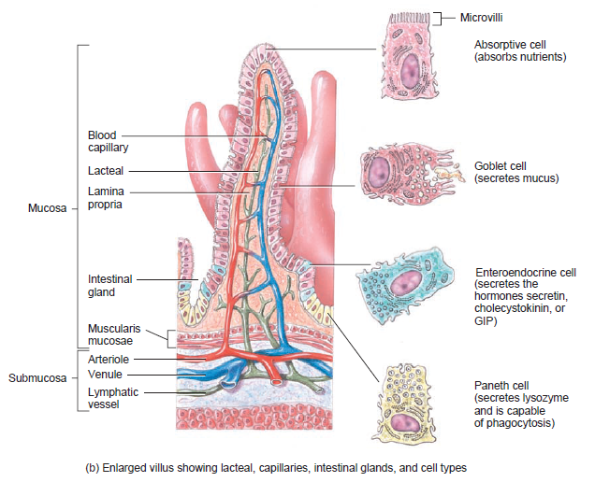
Villa and microvill

Slide 10
Intestinal juice and brush-border enzymes
Intestinal is composed of water and mucus and slightly alkaline (pH 7.6)
Intestinal juice mixes with pancreatic secretions to provide absorptive medium
Absorptive cells in small intestine contain several enzymes called BRUSH-BORDER ENZYMES
Among the brush-border enzymes are:
Carbohydrate digesting enzymes
Protein digesting enzymes (peptidases)
Nucleotide digesting enzymes

Slide 11
Brush-border enzymes
Carbohydrate-digesting enzymes are;
α-detrinase
Maltase
Sucrase
Lactase
Protein-digesting enzymes (peptidases)
Aminopeptidase
Dipeptidase
Nucleotide-digesting enzymes
Nucleosidases
Phosphatases
Enterokinase

Slide 12
Pancreas
Pancreas is a retroperitoneal gland about 12-15cm long and 2.5cm thick
Pancreas consist of head, body and tail
Pancreas has exocrine cells that secrete pancreatic juice through pancreatic duct or duct of Wirsung. Common bile duct joins pancreatic duct forming a dilated common duct called hepatopancreatic ampulla(ampulla of vater)

Slide 13
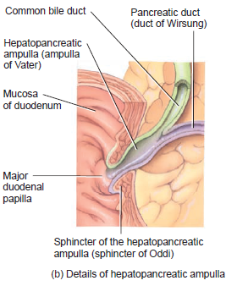
Pancreas
The ampulla of vater opens into the duodenal mucosa at a point called major duodenal papilla that lies 10cm inferior to the pyloric sphincter

Slide 14
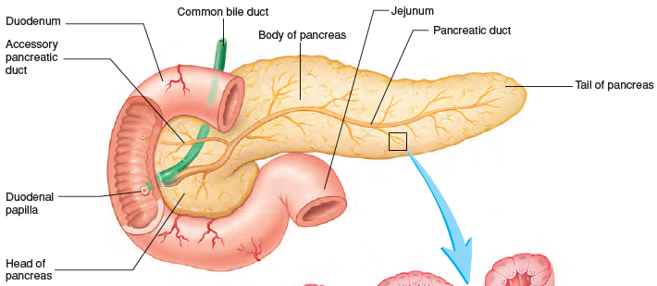
Pancreas

Slide 15
pancreas
The passage of pancreatic juice is regulated by a sphincter called sphincter of hepatopancreatic ampulla or sphincter of Oddi
Pancreas also has accessory duct (duct of santorini) that is located 2.5 cm superior to the hepatopancreatic ampulla

Slide 16
Pancreatic cells
Pancreas is made of small clusters glandular epithelial cells
99% of these cells are exocrine and are called acini
Acini cells secrete pancreatic juice made of a mixture of fluids and digestive enzymes
The remaining 1% of the clusters called pancreatic islets (islet of langerhan) form the endocrine portion

Slide 17
Pancreatic
Islets of langerhans secretes the following hormones
Glucagon
Insulin
Somatostatin
Pancreatic polypeptide

Slide 18
Composition of pancreatic juice
Daily output is about 1200-1500mL
It is a clear and colorless liquid consisting of
Water
Salts
Sodium Bicarbonate
enzymes
Sodium bicarbonates functions as
buffering acidic gastric juice to alkaline (pH of 7.1 – 8.2)
Deactivating pepsin from the stomach
Creating ideal pH for action of intestinal enzymes

Slide 19
Pancreatic enzymes
Pancreatic amylase (carbohydrate-digesting enzyme)
Protein digesting enzymes
Trypsin
Chymotrypsin
Carboxypeptidase
Elastase
Triglyceride-digesting enzymes
Pancreatic Lipase
Nucleic acid-digesting enzyme
Ribonuclease
Deoxyribonuclease

Slide 20
Pancreatic enzymes
Trypsin is secreted as trypsinogen
Chymotrypsin is secreted as chymotrypsinogen
Pancreatic acinar cells also produce an enzyme called trypsin inhibitor that can neutralize any trypsin form accidentally in the pancreas
When trypsinogen reaches small intestine, enterokinase (brush-border enzyme) activates it to trypsin
Trypsin then activates precursors of chymotrypsiongen, procarboxypeptidase, proelastase to active forms i.e. chymotrypsin, carboxypeptidase, and elastase

Slide 21
chemical digestion of carbohydrate in the small intestine
Enzymes | Source | Substrate | End Products
Pancreatic amylase | Pancreas | Polysaccharides | Maltose
Sucrase | Small intestine | Sucrose | Glucose and fructose
Maltase | Small intestine | Maltose and maltotriose | Glucose and glucose
Lactase | Small intestine | Lactose | Glucose and galactose
Α-Dextrinase | Small intestine | Dextrin, maltose, maltriose | Glucose

Slide 22
Absorption of carbohydrate
The final break down of carbohydrates are monosaccharides
All properly digested products are absorbed leaving only cellulose and fibers in faeces
Fructose is transported via facilitated diffusion
Glucose and galactose via active transport assisted by potassium pump i.e. glucose/galactose and Na⁺ transport is driven by Na⁺ concentration gradient provided by sodium-potassium pump
Diffusion of Na⁺ downs its concentration gradients provides energy for transport of glucose and galactose across cell membrane
This process is called cotransport

Slide 23
Chemical digestion of protein in the small intestine
Enzymes | Source | Substrate | End products
Trypsin | Pancreatic acinar cells | Proteins | Peptides
Chymotrypsin | Pancreatic acinar cells | Proteins | Peptides
Elastase | Pancreatic acinar cells | Proteins | Peptides
Carboxypeptidase | Pancreatic acinar cells | Amino acid at carboxyl end of peptide | Amino acids and peptides
Aminopeptidase | Small intestine (brush-border) | Peptides | Amino acids and peptides
Dipeptidases | Small intestine (brush-border) | Peptides | Amino acids

Slide 24
Absorption of amino acids
Amino acids are absorbed via active transport in the duodenum and jejunum in a similar way like glucose
sodium-dependent amino acid cotransporters move amino acids into epithelial cells and to the blood stream
Amino acid is then transported through portal vein to the liver and modification are done and then taken to the tissues

Slide 25
Chemical digestion of lipids
Lipids are present in diet as triglyceride (one molecule of glycerol and 3 molecules of fatty acids)
Triglyceride molecule is acted upon by three enzymes lingual lipase, gastric lipase and pancreatic lipase
Pancreatic lipase breaks triglycerides into fatty acids and monoglycerides
Lipids are emulsified(large lipids broken down into smaller lipids molecules) by bile salts before enzymatic action can take place
Bile salts are amphipathic i.e. has both hydrophobic and hydrophilic region. This property gives bile salt ability of emulsification of lipids into small globules
Emulsification of lipids increases surface area for fat pancreatic lipase activity

Slide 26
Absorption of lipids
Lipids are absorbed via simple diffusion to the lacteals of a villus
In adult 95% of lipids are absorbed while 85% infants are absorbed in infants
Triglycerides are broken down after emulsification to monoglycerides and fatty acids that are either short or long chains
short chain fatty acids are hydrophobic dissolved in watery intestinal chyme and are absorbed into absorptive cells by simple diffusion
Long chain fatty acids are hydrophobic and binds with bile salt to form micelles that helps its absorption

Slide 27
Absorption of lipids
Within the absorptive cells, long chain fatty acid binds with monoglycerides to form triglycerides that aggregate with phospholipids and cholesterols.
This aggregate is now called chylomicrons and are shade off from the absorptive cells by exocytosis. However, chylomicron is large and can not enter capillaries
Chylomicrons enter lacteals and transported by lymphatic vessel to the thoracic duct and enter blood at the left subclavian vein

Slide 28
Digestion of nucleic acids
Enzymes | Source | Substrate | End products
Nucleasidase Phosphatase | Small intestine (brush-border) | Nucleotides | Nitrogenous bases, pentose, phosphates
Ribonuclease | Pancreatic acinar cells | Ribonucleic acid | Nucleotides
Deoxyribonuclease | Pancreatic acinar | Deoxyribuceic acid | Nucleotides

Slide 29
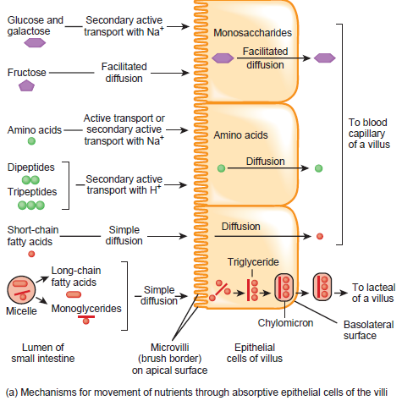
Absorption of nutrients

Slide 30
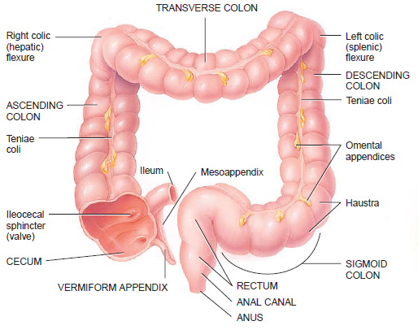
Large intestine

Slide 31
Large intestine
The large intestine is about 1.5m long and 6.5cm in diameter
It is attached posteriorly by mesocolon
The four major regions of the large intestine are
Cecum
Colon
Rectum
Anal canal
Ileocecal sphincter (valve) is a mucus membrane located where ileum opens into the large intestine. It allows content to pass from small intestine to the large intestine

Slide 32
Large intestine
The cecum is the blinding sac (small pouch –approx 6cm )at the junction of small and large intestine
Attached to the cecum is a twisted tubes called appendix or vermiform appendix
Mesoappendix attached appendix to the inferior border of the ileum
Cecum is continuous with the colon
The colon is divided into four parts
Ascending colon
Transverse colon
Descending colon
Sigmoid colon

Slide 33
Large intestine
Sigmoid colon is S-shaped starting at left iliac crest and projecting medially and terminates as rectum at the level of the third sacral vertebra
Rectum is about 20 cm long lying anteriorly to the sacrum and coccyx. The terminal 2-3cm of the ileum forms anal canal
The mucous membrane of anal canal is arranged longitudinal folds called anal column
Anal column has a many network of arteries and vein. It can be dilated abnormally (hemorrhoids)

Slide 34
The opening of large intestine to the exterior called anus is guarded by two sphincters
Internal anal sphincter made of smooth muscles (involuntary)
External anal sphincters made of skeletal muscles (voluntary)
The sphincters keep the anus closed except during defecation

Slide 35
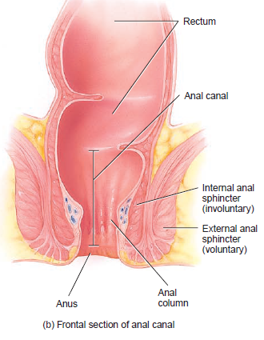
Rectum and anal canal

Slide 36
Functions of large intestine
Haustral churning, peristalsis, and mass peristalsis drive the contents of the colon into the rectum.
Bacteria in the large intestine convert proteins to amino acids, break down amino acids, and produce some B vitamins and vitamin K.
Absorbing some water, ions, and vitamins.
Forming feces.
Defecating (emptying the rectum).

Slide 37
Mechanical digestion in large intestine
Ileocecal sphincter controls movement of chyme into the large intestine
In the large intestine, there is a haustral churning of chyme where haustra remains relax as it fills up. At a certain point of filling, haustra contracts and pushes contents forward
There is small peristalsis also taking place
The final movement called mass movement starts in mid transverse colon and drive the content into the rectum

Slide 38
Chemical digestion in large intestine
In large intestine, there is no enzyme secreted. Only mucus is secreted by glands in large intestine
Chyme is prepared for elimination by bacterial action
The remaining carbohydrate is fermented releasing hydrogen, CO₂, methane gases. These gas form flatus and when excess it is called flatulence
Bacteria also convert remaining proteins into amino acid. The amino acid is broken into simpler substances like hydrogen sulphide, indole, and skatole. Indole is eliminated in feces and contributes to its odor

Slide 39
Defecation reflex
When feces reaches the rectum, it causes distention of the rectal wall and stimulate stretch receptors
Impulse from stretch receptors are sent to the sacral portion of the spinal cord.
Motor impulse from the cord travels through parasympathetic nerves to the descending colons, rectum and anus
This impulse contract the rectal muscles increasing the pressure within rectum
The increased pressure together with voluntary contractions of the diaphragm and abdominal muscles and parasympathetic stimulation open the internal anal sphincter

Slide 40
Defecation reflex
External anal sphincter is voluntarily controlled
When you voluntarily relax it defecation occur and feces is pushed out of anus
When you voluntarily constrict it, defecation is postponed
If defecation does no occur feces backup into the sigmoid colon until the next waves of peristaltic movement stimulate stretch receptors

